Slide 1
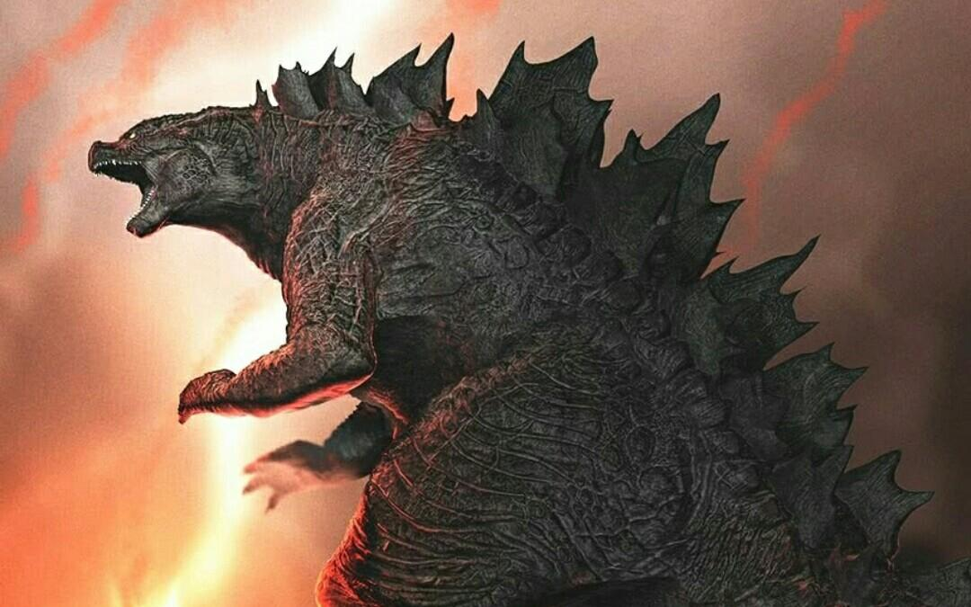
Kaiju Classification
Xiongjian Chen & Yiru Wang
Electrical & Computer Engineering

Slide 2
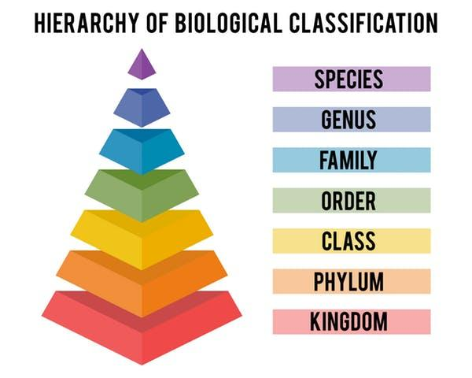
Introduction
Taxonomic classification:
One of the major biological questions in metagenomics is the inference of the composition of a microbial community, that is, the relative abundances of the sampled organisms.

Slide 3
Introduction
Methods:
Comparing to reference database
Assembly reads to contigs
Individual reads to taxa using local sequence alignment(nucleotide-level or protein-level)
Hash-based index structures built using k-mers index(Kraken, Clark.etc)
Notes:
Additional Computational difficulty
Too slow
To achieve high speed, these algorithms do not use traditional local alignment methods, but rely on the identification of k-mers, short exact matching substrings of fixed-length k, in order to compare two nucleotide sequences. For the taxonomic assignment of reads, these programs typically preprocess the reference genomes by extracting all contained k-mers and storing them in the index for fast lookup.
a sampling bias in the phylogenetic distribution of available reference genomes. On the one hand, certain model organisms or pathogens, for example, from human microbiomes, are primary targets for microbial research and are therefore over-represented in the genome databases. On the other hand, species that were not possible to culture in the laboratory are underrepresented

Slide 4
Introduction
Protein-level classification:
Conserved than the underlying DNA
Microbial and viral genomes are typically densely packed with protein-coding genes
More tolerant to sequencing errors(degeneracy of the genetic code)
BlastP, BlastX, RapSearch and Diamond

Slide 5
Introduction
Kaiju classification:
Kaiju classifies individual metagenomic reads using a reference database comprising the annotated protein-coding genes of a set of microbial genomes
finds maximal exact matching(MEM) substrings between query and database using a modified version of the backwards search algorithm in the BWT

Slide 6
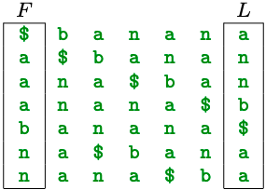
Introduction
Burrows-Wheeler Transform(BWT):
The BWT is a text transformation that converts the reference sequence database into an easily searchable representation
BWT of string “banana”
Notes:
lexicographical ordered

Slide 7
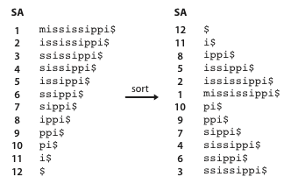
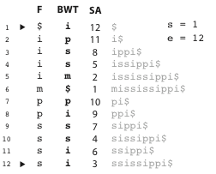
Introduction
BWT backward search algorithm:
Original string S: ”mississippi$”
Query string P: ”iss”
where s is the start index; e is end index(length of the query string); SA is suffix arrays; BWT: the i^{th} symbol of the BWT is the symbol just before the i^{th} suffix; F is the first character of suffix array.
Notes:
substring
FM-index
lexicographical ordered

Slide 8

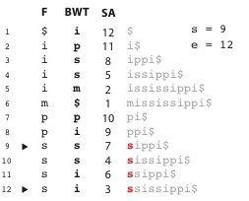
Introduction
BWT backward search algorithm:
Start with P = “iss”, i = 3;
s′=C[P[i]]+rank(s−1,P[i])+1
e′=C[P[i]]+rank(e,P[i])
where P is any pattern in S(original string)
C is a lookup table containing the count of all different symbols in our alphabet which sort lexicographically before P[i];

Slide 9
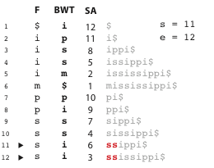
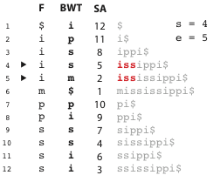
Introduction
BWT backward search algorithm:
i = 2
i = 1
Notes:
s’ = 8 + rank(8,s) + 1 = 11
e’ = 8 + rank(12,s) = 12
s’’ = 1+rank(10,i) +1= 4
e’’ = 1+rank(12,i) = 5

Slide 10
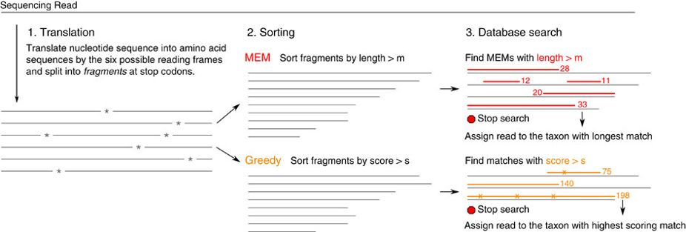
Introduction
BWT backward search algorithm:
MEM: Maximal exact matching NCBI BLAST nr +euk
Score: BLOSUM62 score
Notes:
Translates each read into the six possible reading frames, which are then split at stop codons into amino acid fragments
MEM:
If equally long matches are found in multiple taxa, Kaiju determines their LCA from the taxonomic tree (Supplementary Fig. 6) and outputs its taxon identifier. Thus, each read is always classified to the lowest possible taxonomic level given the ambiguity of the search result.
Greedy:
Therefore, allowing for substitutions during the backwards search can bridge mismatches and extend the match at the cost of an exponential increase of runtime depending on the number of allowed mismatched positions.
Therefore, we also implemented a Greedy search mode in Kaiju, which first locates all MEMs of a minimum seed length (default 7) and then extends them by allowing substitutions at the left ends of each seed match. From there, the backwards search continues until the next mismatch occurs. Eventually the search stops once the left end of the query is reached or if the maximum allowed number of substitutions has been reached.
Score:
Therefore, after the translation of a read into a set of amino acid fragments, we rank the fragments by their BLOSUM62 score and start the database search with the highest scoring fragment. For each substituted amino acid, the modified fragment is placed back into the search list according to its new (now lower) score. Once a match is found, which has a higher score than all remaining fragments in the search list and a score above the minimum score threshold s, the search stops and this highest scoring match is used for classifying the read.
Reads are directly assigned to a species or strain, or in case of ambiguity, to higher level nodes in the taxonomic tree.
Sensitivity was calculated as the percentage of reads assigned to the correct genus/phylum out of the total number of reads in the input. Precision was calculated as the percentage of reads assigned to the correct genus/phylum out of the number of classified reads, excluding reads classified correctly to a rank above

Slide 11
Introduction
NCBI BLAST nr +euk:
A shuffled version of the microbial subset of NCBI’s non-redundant protein and eukaryotes database, using uShuffle with a window length of 100 amino acids.
Refrence database:
25M protein sequences from 7065 complete bacterial and archaeal genomes and 9334 viral genomes from NCBI RefSeq.
Notes:
Translates each read into the six possible reading frames, which are then split at stop codons into amino acid fragments
MEM:
If equally long matches are found in multiple taxa, Kaiju determines their LCA from the taxonomic tree (Supplementary Fig. 6) and outputs its taxon identifier. Thus, each read is always classified to the lowest possible taxonomic level given the ambiguity of the search result.
Greedy:
Therefore, allowing for substitutions during the backwards search can bridge mismatches and extend the match at the cost of an exponential increase of runtime depending on the number of allowed mismatched positions.
Therefore, we also implemented a Greedy search mode in Kaiju, which first locates all MEMs of a minimum seed length (default 7) and then extends them by allowing substitutions at the left ends of each seed match. From there, the backwards search continues until the next mismatch occurs. Eventually the search stops once the left end of the query is reached or if the maximum allowed number of substitutions has been reached.

Slide 12
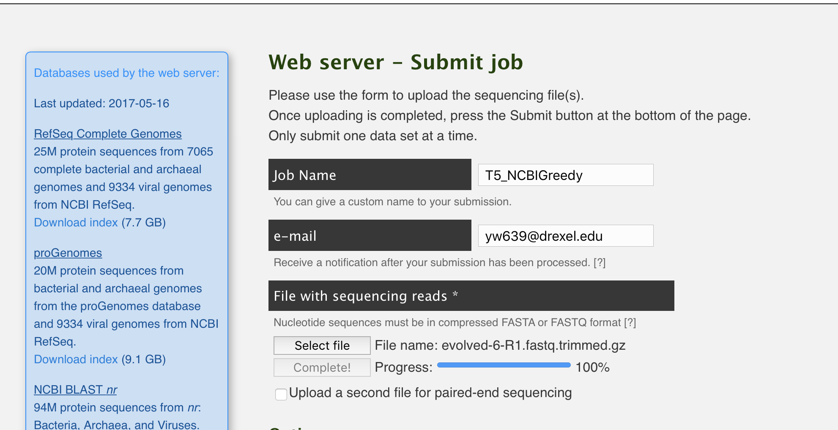
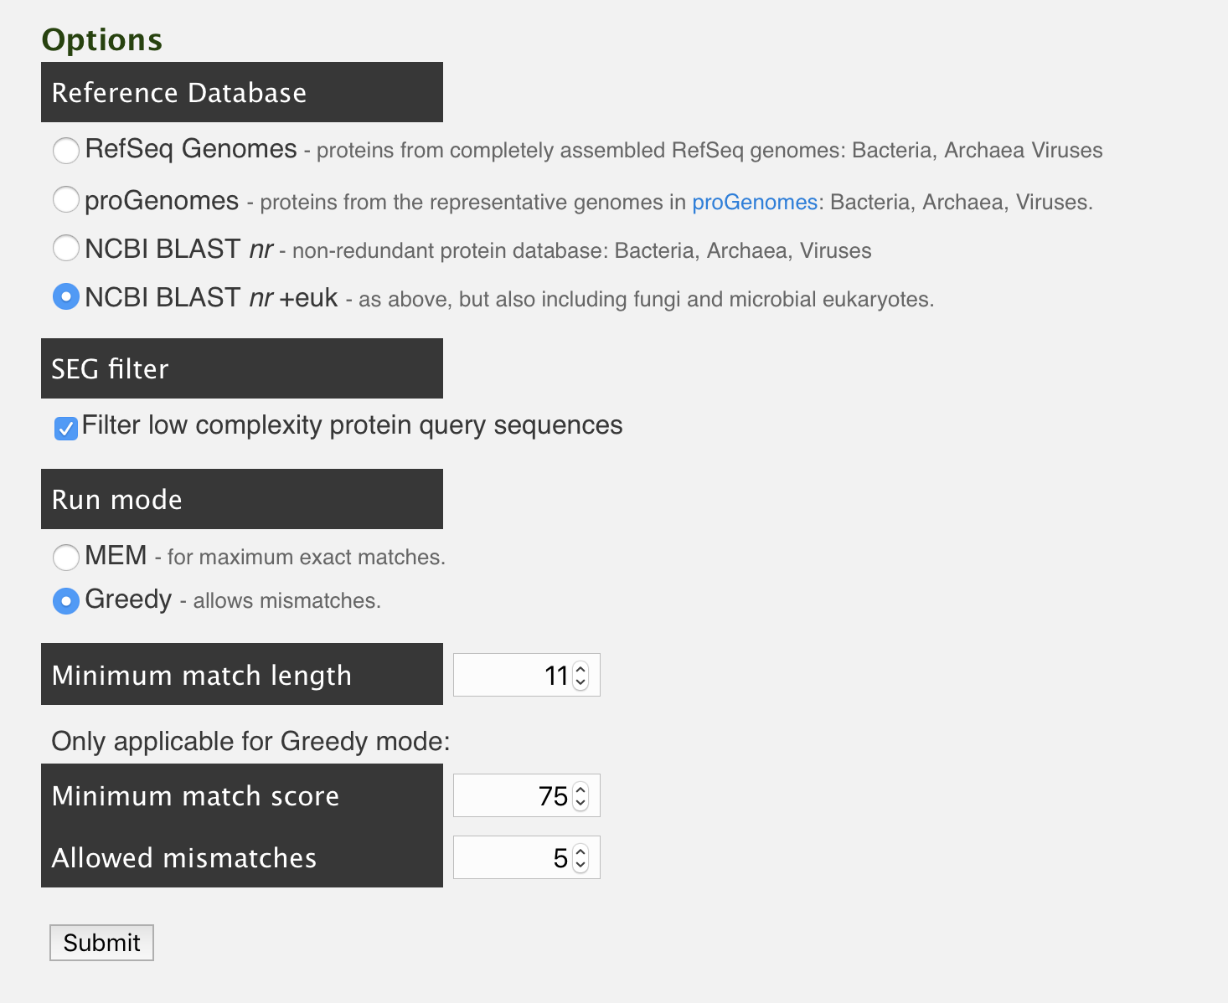
Implementation
Submit Job: http://kaiju.binf.ku.dk/server

Slide 13
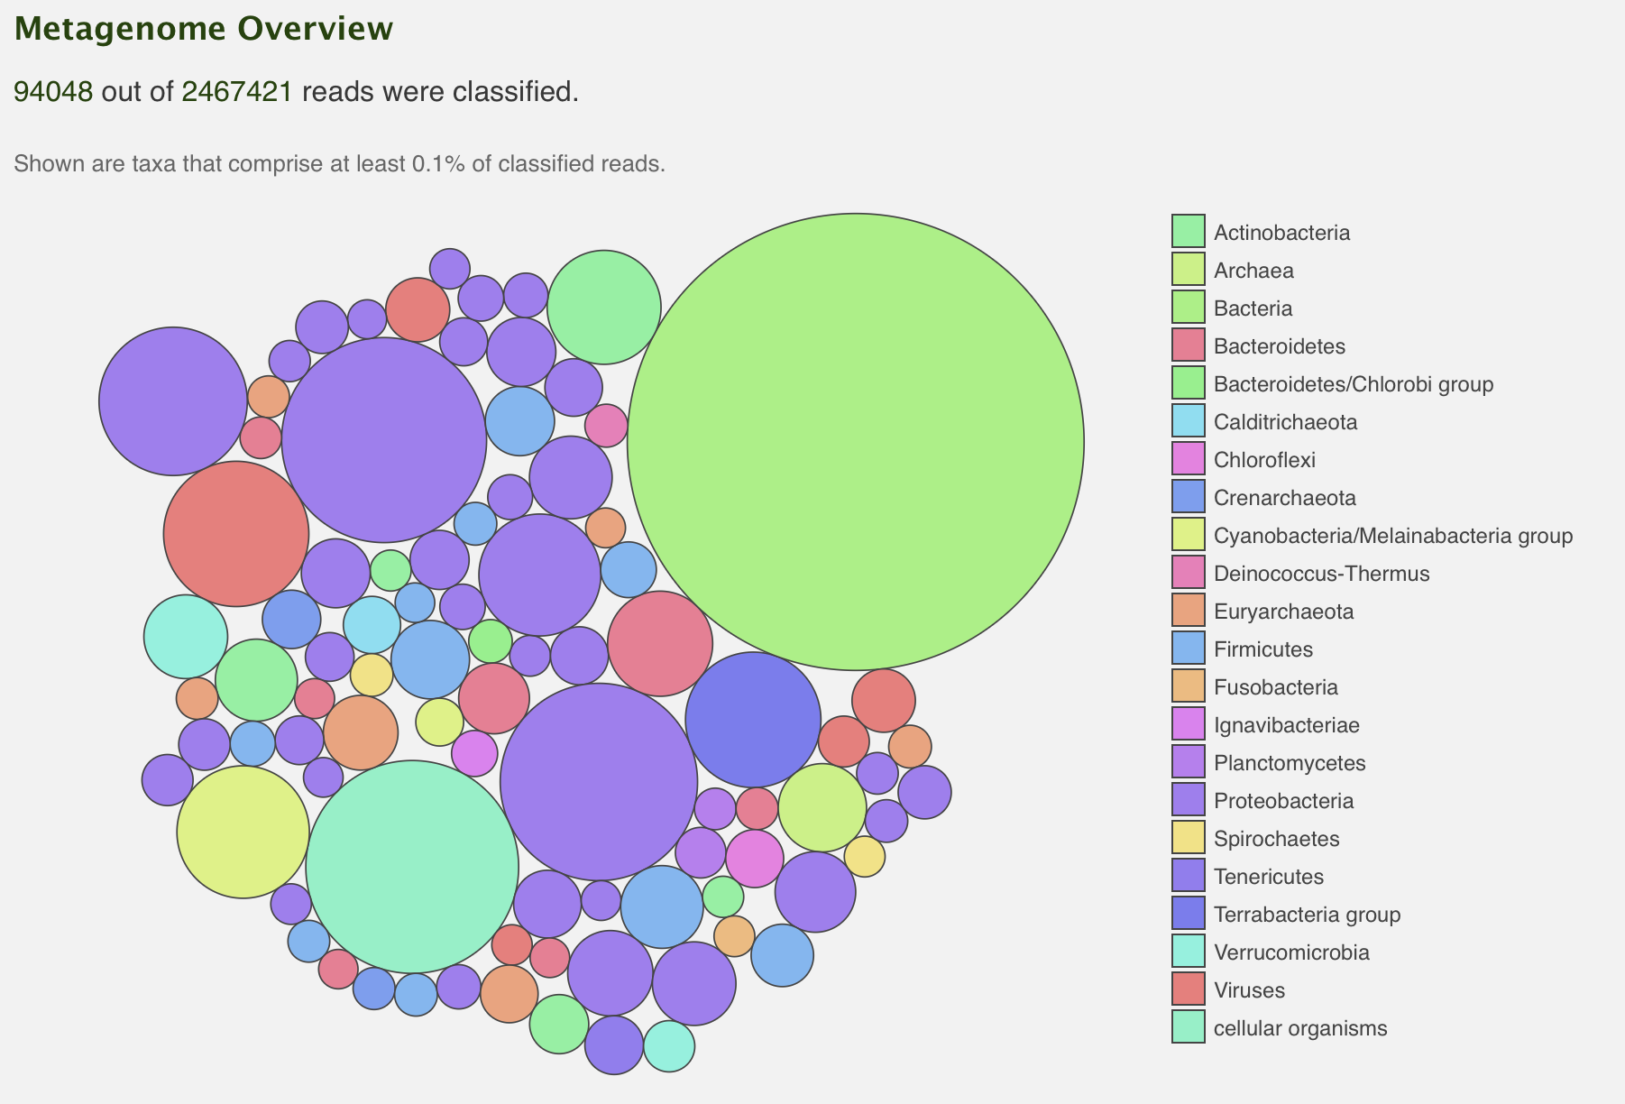
Results
Reference Database: RefSeq Genomes
Run mode: MEM
http://kaiju.binf.ku.dk/results/117685-9526839019

Slide 14
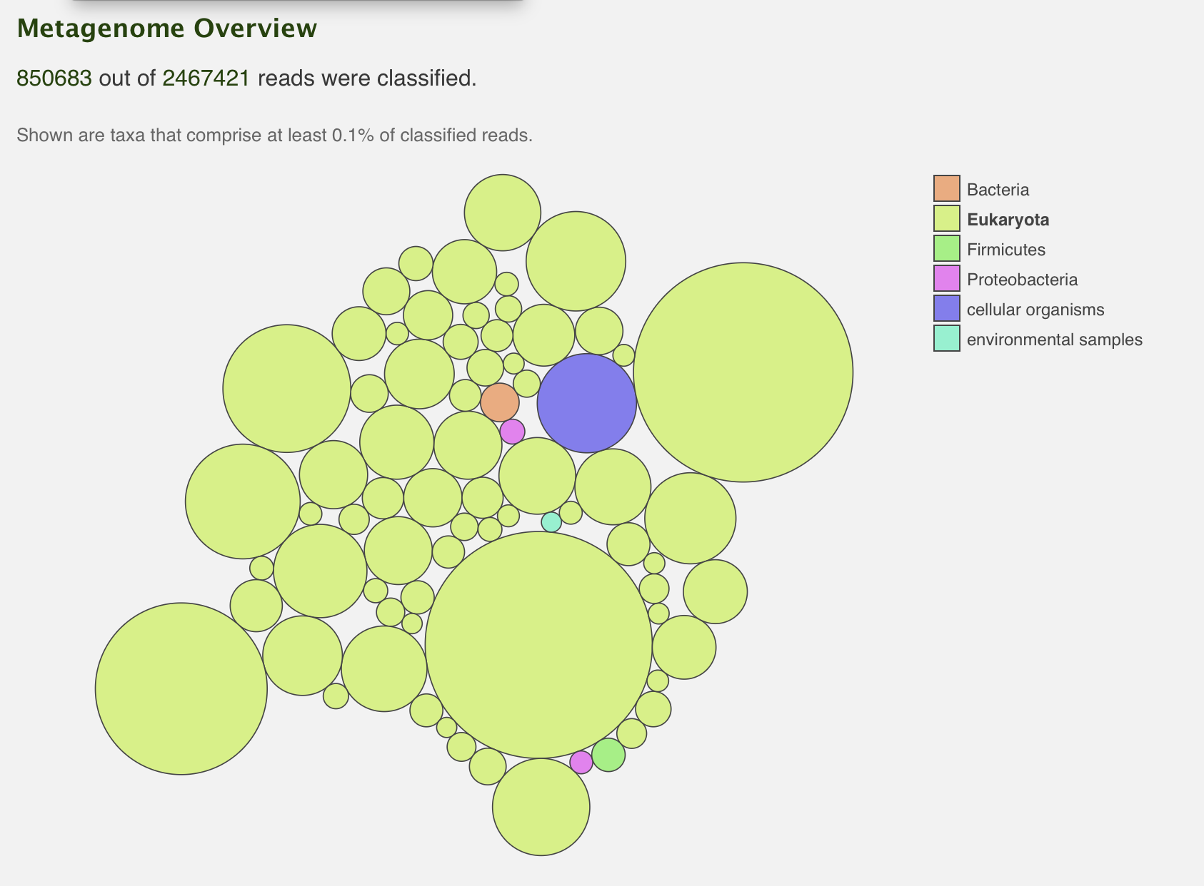
Results
Reference Database: NCBI BLAST nr+euk
Run mode: MEM
http://kaiju.binf.ku.dk/results/117687-2970779367

Slide 15
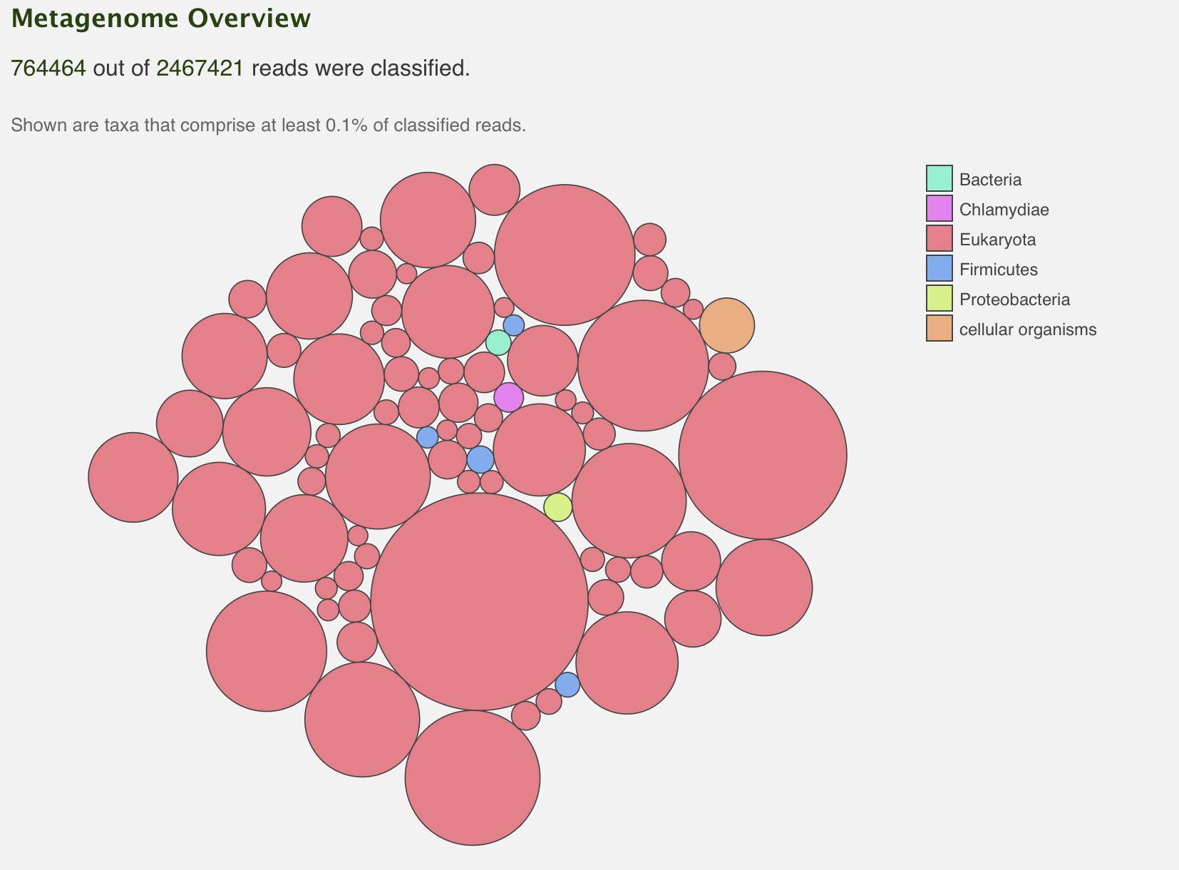
Results
Reference Database: NCBI BLAST nr+euk
Run mode: Greedy
http://kaiju.binf.ku.dk/results/117688-6664896059

Slide 16
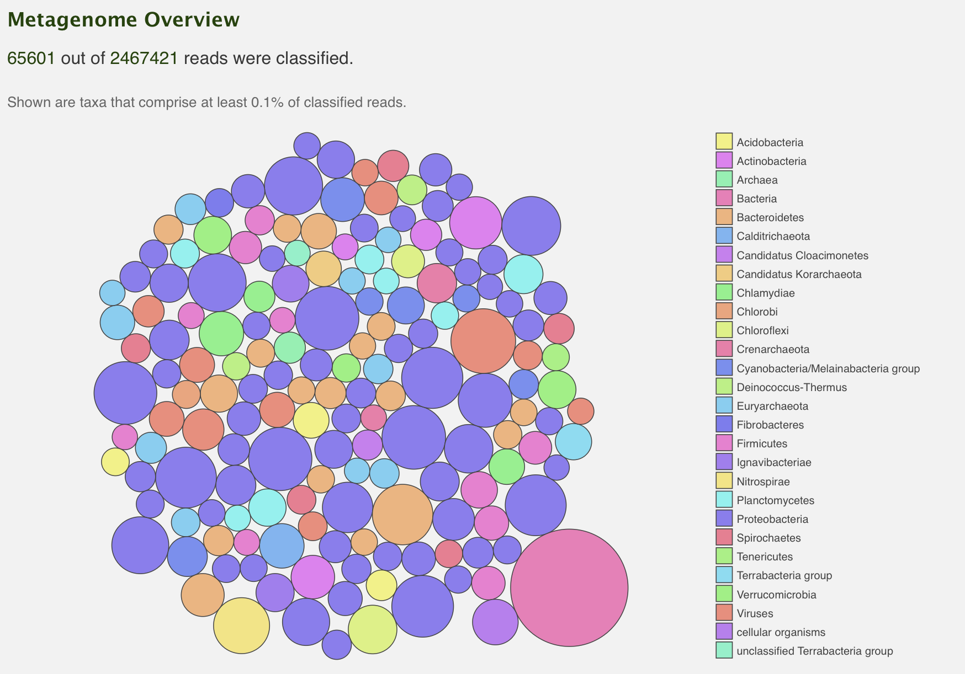
Results
Reference Database: RefSeq Genomes
Run mode: Greedy
http://kaiju.binf.ku.dk/results/117686-0344058917

Slide 17
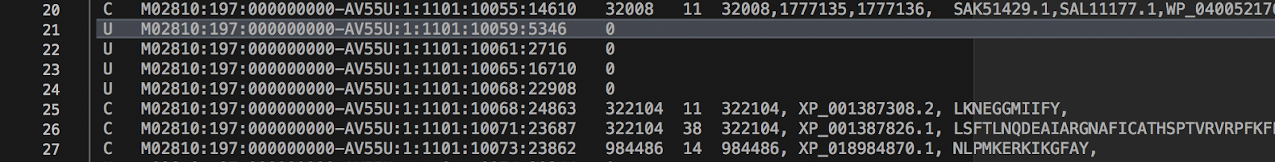
Output Results
Column 1: The reads is classified or unclassified
Column 4: the length or score of the best match used for classification
Column 5: the taxon identifiers of best matching database sequence(s), from which the LCA in column 3 is calculated

Slide 18

Thank you!

